Slide 1
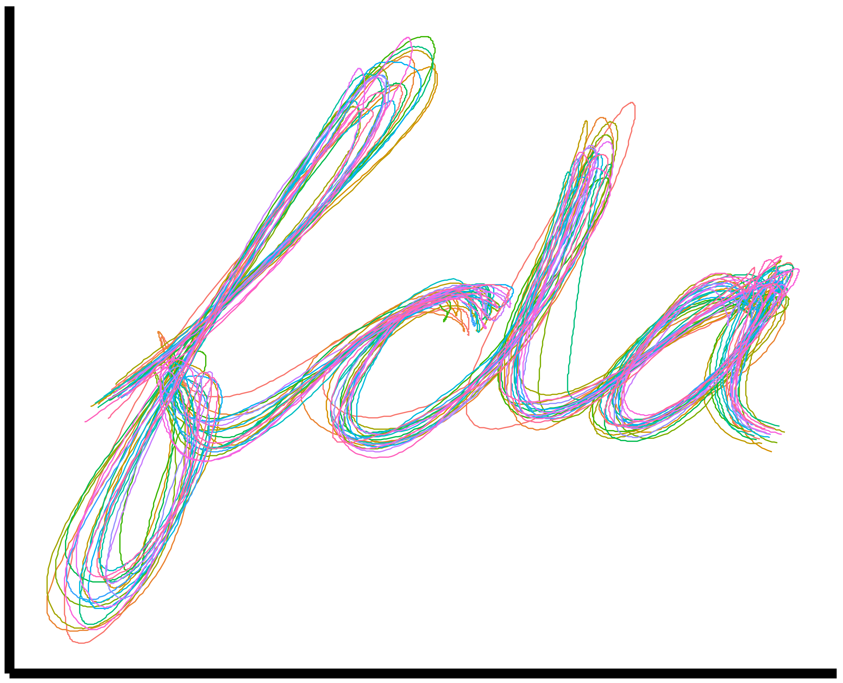
Functional Data Analysis for Sports Biomechanics
Prof. Drew Harrison (University of Limerick)
Dr. Edward Gunning (University of Pennsylvania)
ISBS 2024
Pre-conference Workshop
July 15th, 2024

Slide 2
Introduction to Functional Data Analysis (FDA)

Slide 3
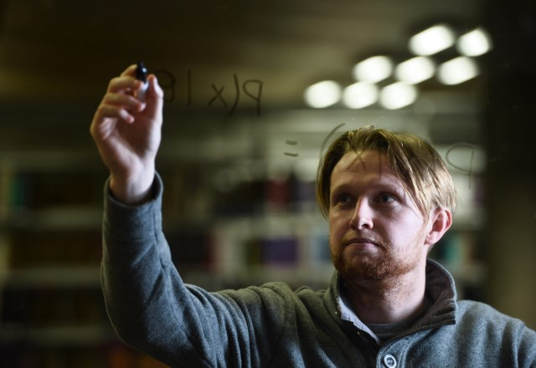


Welcome

Slide 4

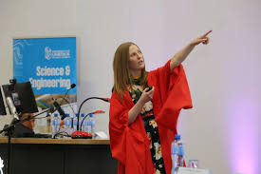


Before starting, I must thank:
+ past and current mentors and collaborators who have helped shape my thinking in this area!

Slide 5
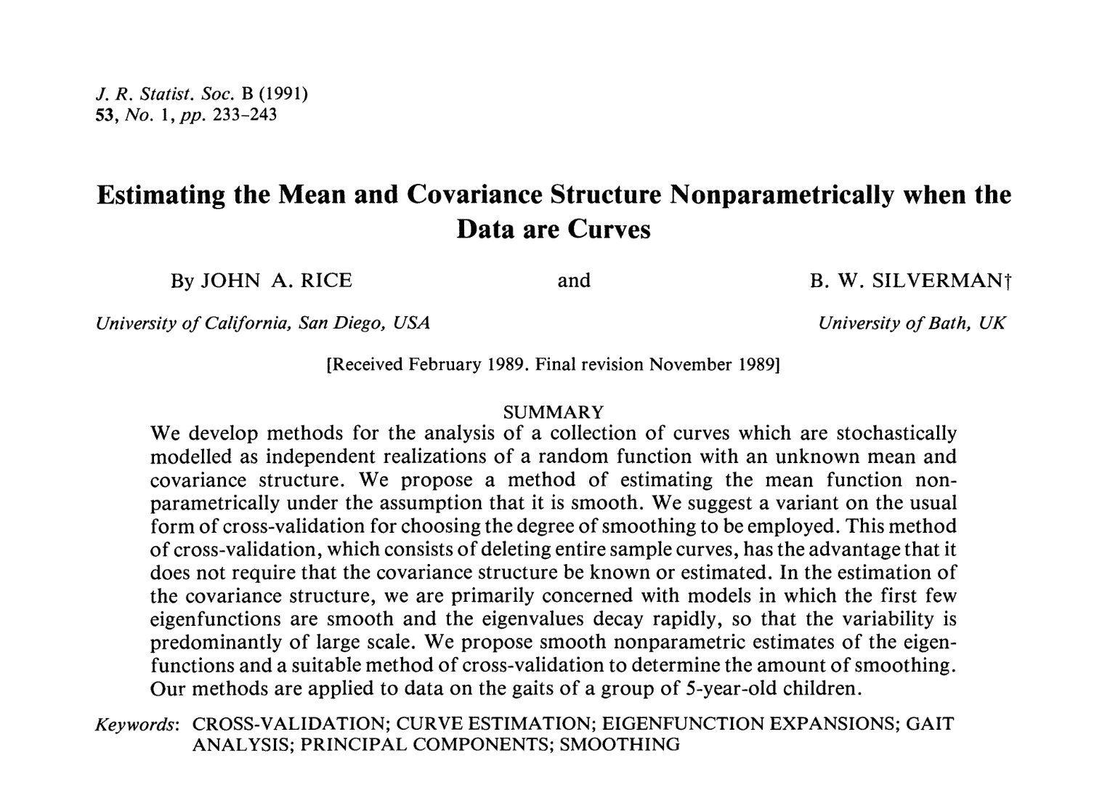
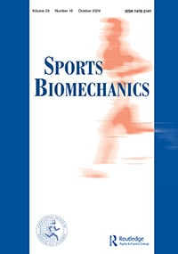

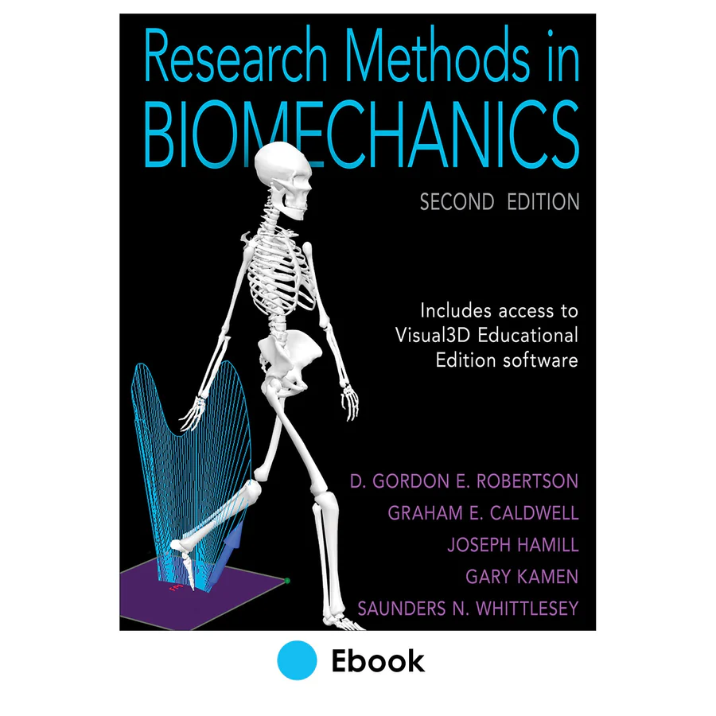

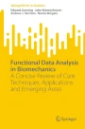
Brief History and Motivation for this Workshop
Early 1990’s: FDA in its genesis, and first applied to human movement (gait), e.g., Rice and Silverman (1991).
2006: First sports biomechanics paper on FDA, “Functional data analysis of knee joint kinematics in the vertical jump” by Willian Ryan, Drew Harrison and and Kevin Hayes in Sports Biomechanics.
2009: ISBS Symposium, Limerick : Recent developments in data analysis. (Norma Coffey)
2014:
Research Methods in Biomechanics chapter 14 Biomechanical analysis of Waveform data. Kevin Deluzio, Norma Coffey & Drew Harrison .
ISBS Dyson Lecture: Applications of Functional Data Analysis in sport biomechanics. Drew Harrison.
2023: Hans Gros Emerging Researcher Presentation. Over 30 years of functional data analysis in human movement. John Warmenhoven.
2024:
Our SpringerBriefs book “Functional Data Analysis in Biomechanics”
Pre-conference workshop at ISBS 2024 in Salzburg.

Slide 6
A Brief History and Motivation

Slide 7
Outline of the Workshop
The workshop is in TWO main parts:
An examination of Functional Data Analysis (FDA) and its applications in biomechanics
Describe FDA and the various steps
Consider examples of applications of FDA in Sport and exercise related biomechanics
An interactive practical using R (materials on our GitHub site)
Notes:
I suppose I should let you know main things I intend to talk about today.
Deciding on this was a real challenge, but in the end – I decided to attempt the impossible and base the presentation on two apparently different research interests that I had over many years.
Firstly: I want to examine the applications of Functional Data Analysis (FDA)
Secondly: I’ll talk about the role of leg stiffness in running and jumping
And finally- I’m going to try and find some common ground between these two themes

Slide 8
Schedule
The schedule is intended to be flexible with various breaks to facilitate interaction and discussion:
Time | Topic | Format
10:00 – 10:30 | Welcome and Introduction | Lecture
10:30 – 10:50 | Coffee Break
10:50 – 13:00 | Foundations of FDA | Lecture
13:00 – 14:00 | Lunch
14:00 – 16:00 | Hands-on FDA with R | Practical (Groups)
16:00 - 16:30 | Q&A and Final Remarks | Group Discussion

Slide 9
What do you need?
Your own laptop
Via the various pre workshop emails, you should have been able to access the resources on our GitHub site :
Obtained the various MS Powerpoint slide decks for the presentations
Downloaded and installed R and RStudio
Access to sample data sets, R scripts
Access to example analyses
If you need help in setting up the resources, we can provide this during the breaks between presentations

Slide 10
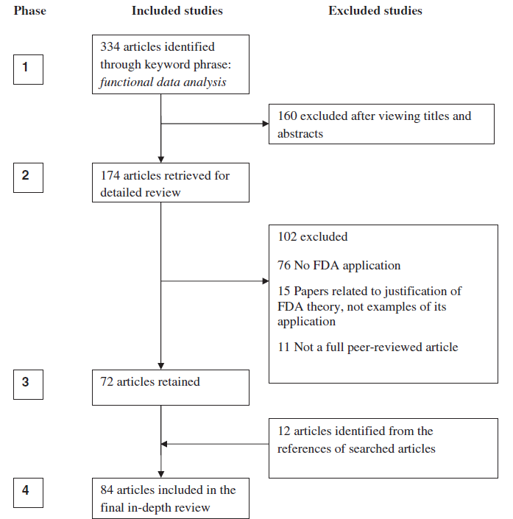
Systematic review of FDA
Ullah and Finch (2013) systematic review of published research in FDA
84 articles in final review
11 on biomechanics mainly gait and fundamental movements
FDA is useful in analysis of time series data (inc. biomechanics) but full appreciation of FDA has been limited
While there has be an increase in FDA in Sports Biomechanics research since 2013, it use is still somewhat limited
Credit: Figure from Ullah and Finch (2013)
Notes:
FDA is a developing field with some important work in the discipline of biomechanics

Slide 11
Background
Hamill (2006) Dyson lecture examined how methods of complex analysis had contributed to the understanding of overuse injuries in sport, concluding:
Traditional methods focus on discrete measures but these are inadequate when considering coordination.
Highlighted the importance of coordination variability
Discrete and continuous relative phase analyses may examine joint and segment coupling coordination in running.
Concluded that those methods could lead to a deeper understanding of the injury process.
Notes:
And so to the presentation…. When I was grappling with what I should do I decided to look back at various Goeffrey Dyson presentations and I was struck by the presentation of Professor Joe Hamill who in 2006 considered “how methods of complex analysis had contributed to the understanding of overuse injuries in sport”
-Traditional methods focus on discrete measures but these are inadequate when considering coordination.
-Highlighted importance of coordination variability
-Discrete and continuous relative phase may examine joint and segment coupling coordination in running.
-Concluded that those methods could lead to a deeper understanding of the injury process.

Slide 12
Background
Much of the data we analyse in biomechanics involves time series or is represented as a curve of some sort.
The focus on discrete point analysis results in a loss of most of the data collected.
Notes:
Follow slide

Slide 13
Background
Much of the data we analyse in biomechanics involves time series or is represented as a curve of some sort.
The focus on discrete point analysis results in a loss of most of the data collected.
“Information Loss” Data thrown away!
Notes:
Follow slide

Slide 14
Background
Much of the data we analyse in biomechanics involves time series or is represented as a curve of some sort.
The focus on discrete point analysis results in a loss of most of the data collected.
We need to find a better way to use all of the information!
Notes:
Follow slide

Slide 15
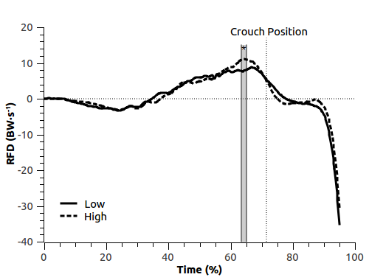
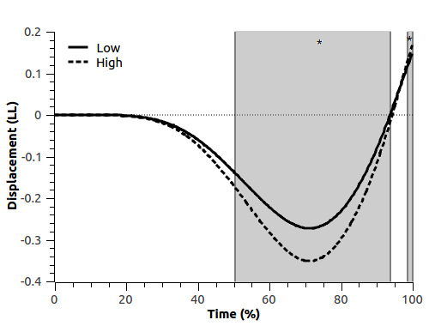
Comparison of mean curves in the vertical jump
Comparing CMJ performance in rugby players by level of performance
Floria et al
Notes:
This slide shows a comparison of vertical jump force time curve analysis using something like a functional t-test to determine what parts of the two ensemble mean curves are significantly different.

Slide 16
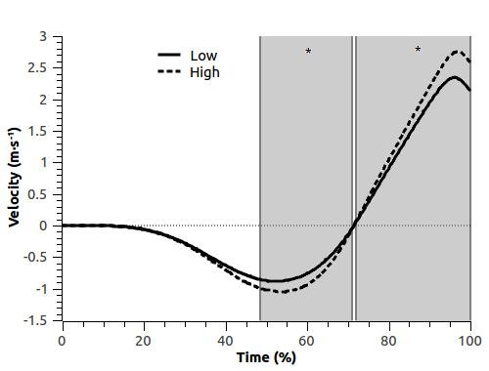
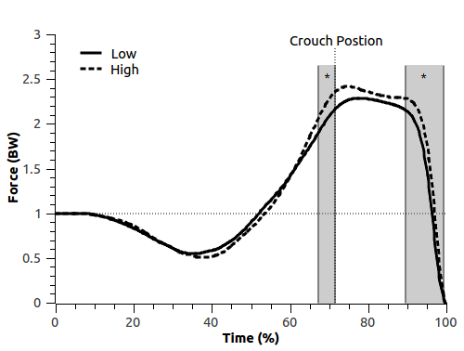
CMJ analysis in Rugby players
Comparing CMJ in Rugby players by performance level
Floria et al

Slide 17
Properties of Functional Data
Functional refers to the intrinsic structure of the data.
While data are often measured at a discrete number of time points but we assume there exists some underlying function x(t) which generates the observed data.
Key idea: SMOOTHNESS.
Adjacent values are somehow linked and it is unlikely that these values are very different from each other.
The functional data possess a number of derivatives.

Slide 18
Properties of Functional Data
(a) Multivariate Data
(b) Functional Data in Practice
(c) Functional Data in Theory
x₂ Weight | x₁ Height | … | x_{P} BP
85 | 182 | … | 110
. . . | . . . | . . . | . . .
76 | 171 | … | 120
x(t₁) | x(t₂) | … | x(t_{n})
-4.33 | -5.26 | … | -4.11
. . . | . . . | . . . | . . .
-3.95 | -5.96 | … | -2.12
.
.
.
Key Distinction: Adjacent values are linked because they are measurements of different parts of the same underlying function

Slide 19

3.0
2.8
2.6
2.4
Knee Angle for Individual Jump
2.2
2.0
1.8
0
20
40
“Time” Index
60
80
100
Notes:
In biomechanics we gather lots of high dimensional data

Slide 20
3.0
2.8
2.6
2.4
Knee Angle for Individual Jump
2.2
2.0
1.8
0
20
40
“Time” Index
60
80
100

Slide 21
Children’s Gait Data
Access it in R:
library(fda)
data(“gait”)
gait
Sagittal hip and knee angles of 39 healthy boys during a single walking stride sampled at 20 time points.
Motivated significant early methodological developments in FDA; see Rice and Silverman (1992) and Leurgans, Silverman and Moyeed (1993).
Highlights the long-standing link between FDA methods and biomechanics as a useful area of application.
Small and simple compared to modern biomechanical data!

Slide 22
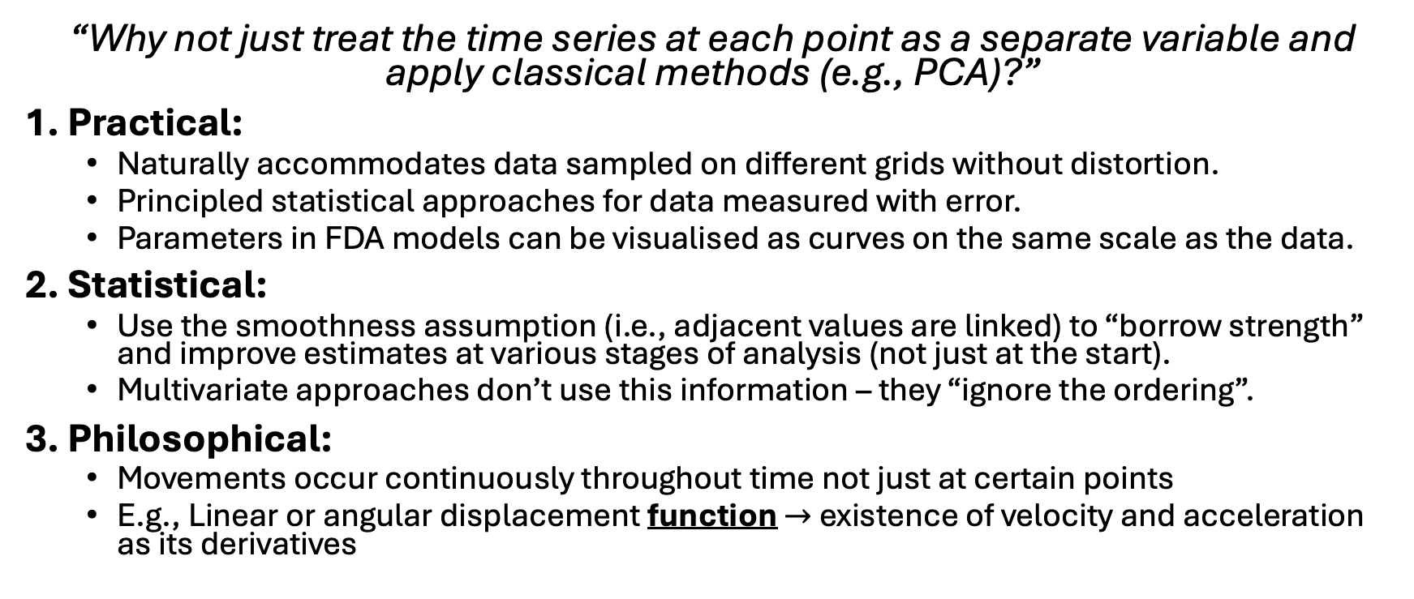
FDA vs. Multivariate Approaches
“Why not just treat the time series at each point as a separate variable and apply classical methods (e.g., PCA)?”
1. Practical:
Naturally accommodates data sampled on different grids without distortion.
Principled statistical approaches for data measured with error.
Parameters in FDA models can be visualised as curves on the same scale as the data.
2. Statistical:
Use the smoothness assumption (i.e., adjacent values are linked) to “borrow strength” and improve estimates at various stages of analysis (not just at the start).
Multivariate approaches don’t use this information – they “ignore the ordering”.
3. Philosophical:
Movements occur continuously throughout time not just at certain points
E.g., Linear or angular displacement function $→$ existence of velocity and acceleration as its derivatives

Slide 23
The various steps in FDA
FDA can be viewed a process that consists of various steps:
Representing (biomechanical) data as functions: Convert discrete sampled series’ of data to smooth curves.
Exploring modes of variation in (biomechanical) data: Exploratory data analysis for curves.
Statistical modelling: Applying functional versions of classical statistical models, e.g., regression.
Presenting the results of analysis: An important step so that results are intuitive and meaningful to practitioners, but often overlooked.

Slide 24
Conclusions about FDA for Sports Biomechanics
FDA augments the complex methods identified by Hamill (2006) – but is more flexible than other methods for evaluating movement variability and coordination
Provides a flexible “toolkit” for researchers working with data presenting as curves
Its use is still not widespread in biomechanics or sports biomechanics
Although extensive software is made available by the statistics community (e.g., see CRAN task view), demonstrations and guidance on its use in practical biomechanics settings is lacking
We hope to address these challenges today!

Slide 25
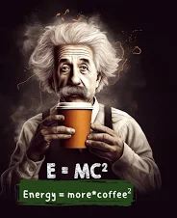


Technical information on FDA steps
…..and what now ?
…. and next ?

